Slide 1
SUPPORTED BY
YOUTH
HOMELESSNESS

Slide 2
SUPPORTED BY

Slide 3
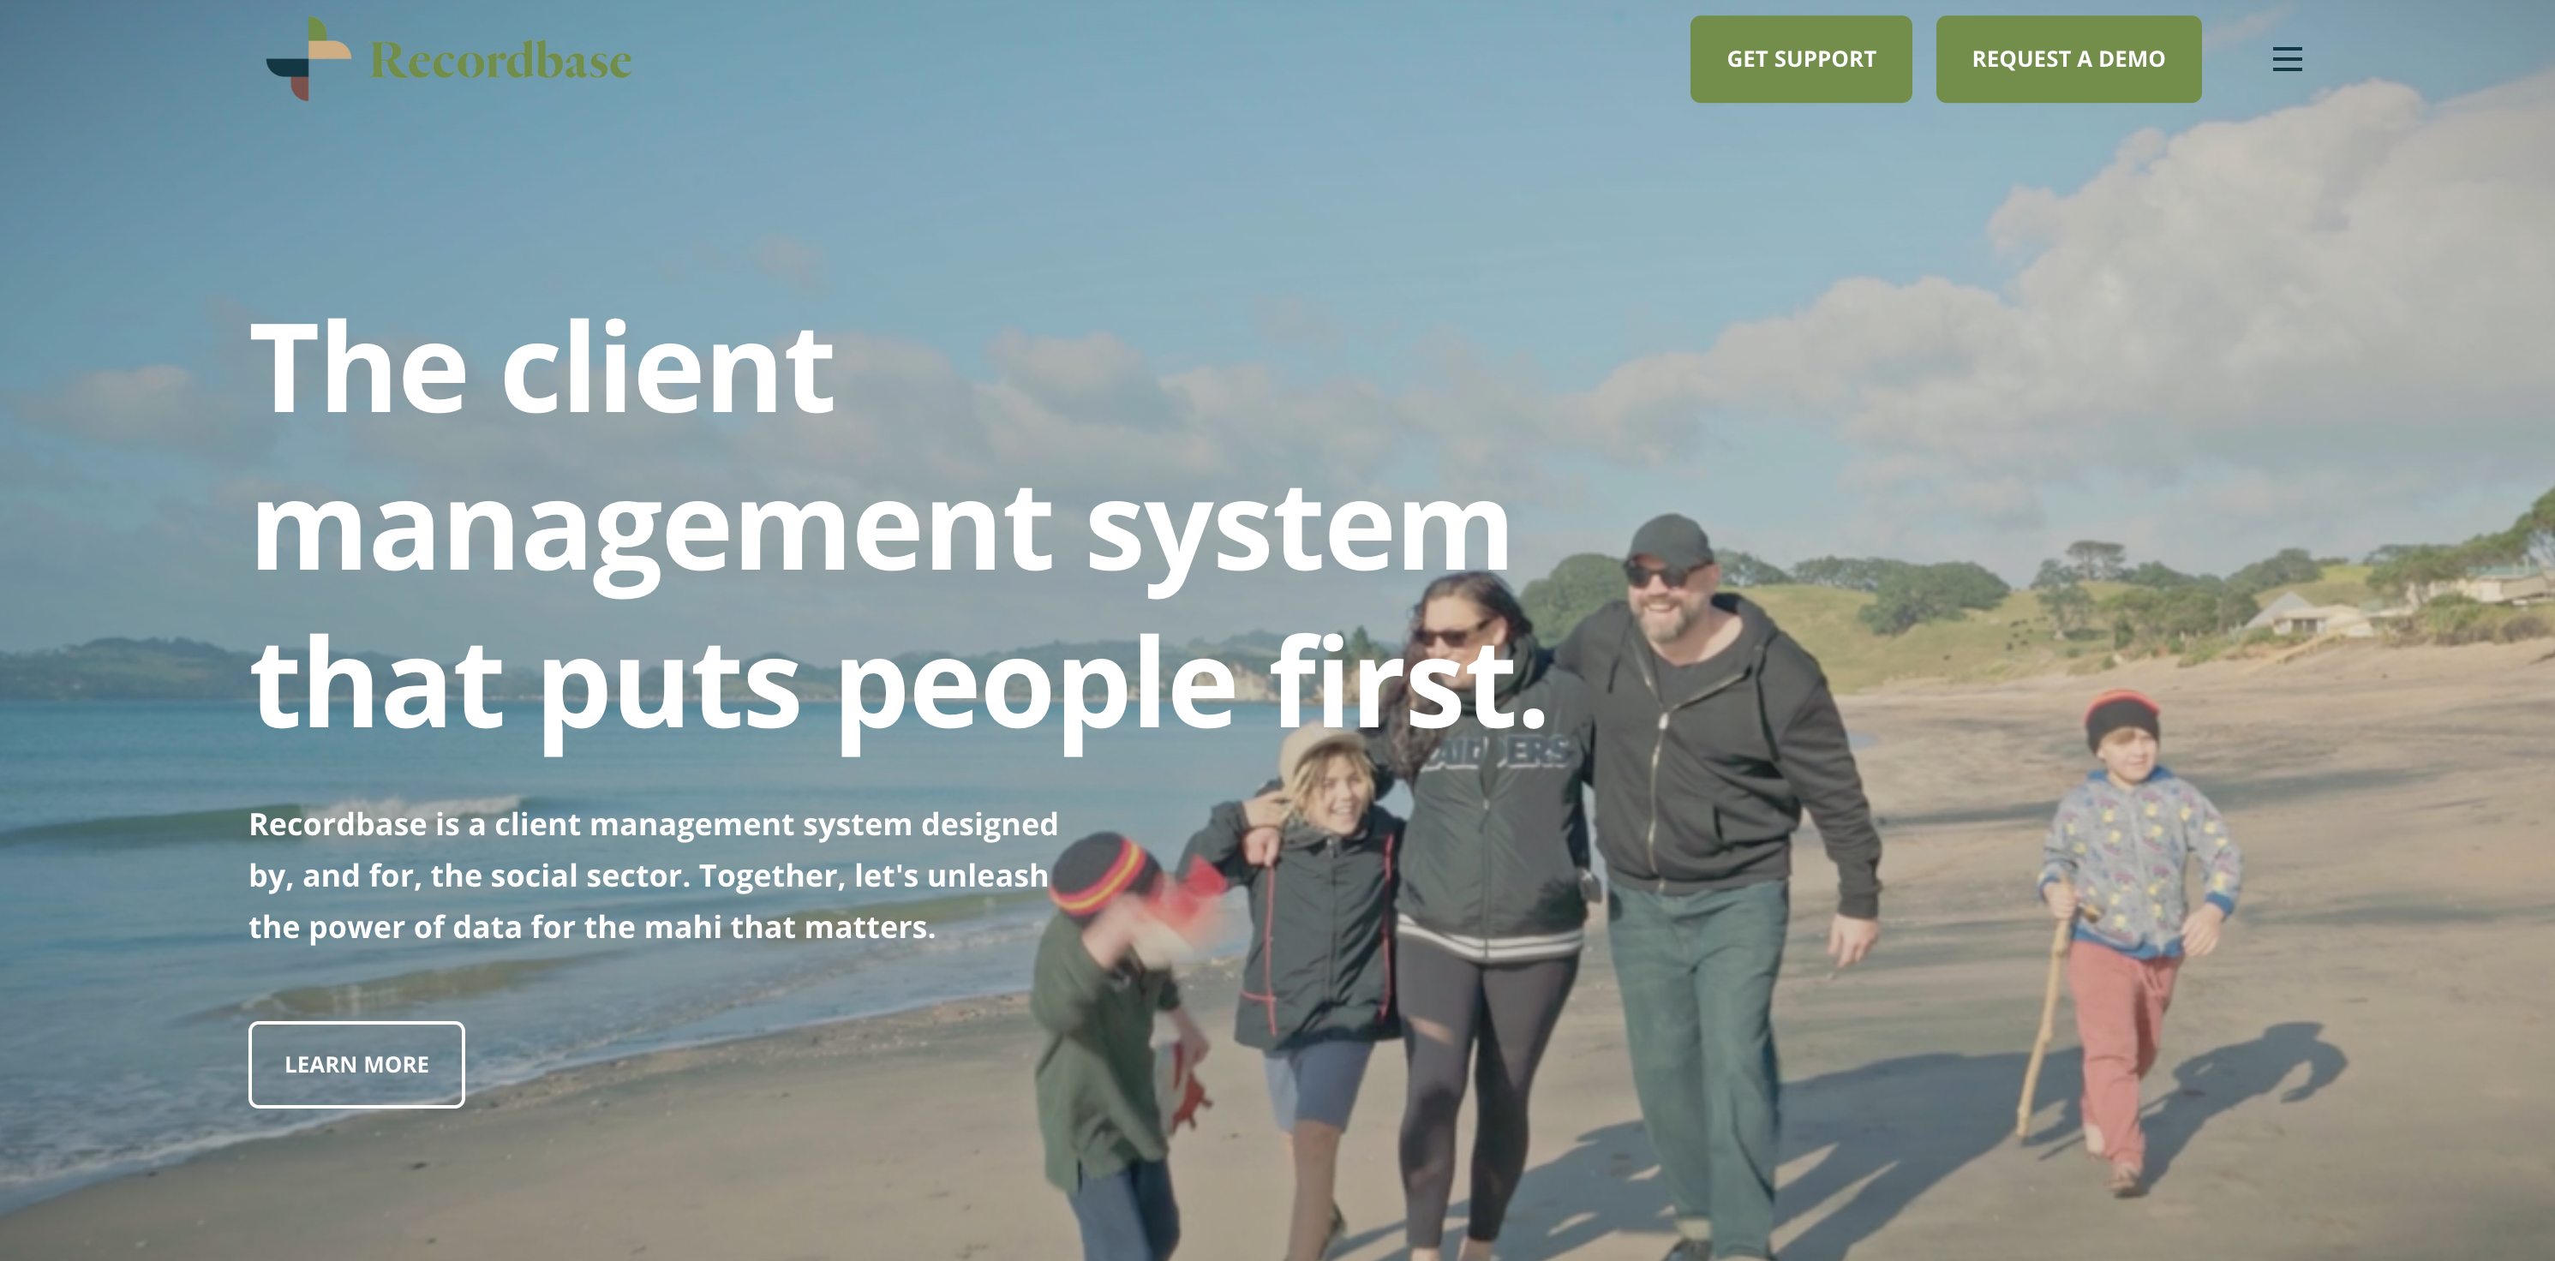
SUPPORTED BY

Slide 4
SUPPORTED BY

Slide 5
SUPPORTED BY

Slide 6
SUPPORTED BY
YOUTH
HOMELESSNESS

Slide 7
WHAT WE KNOW
Over 50% of our homeless population are rangatahi
45% of people surveyed in Auckland’s 2018 homeless count were under 18
In Feb 2022, 18% of those accessing emergency accommodation were YP.
Estimated almost 2000 young people were in Emergency accommodation – end of June quarter 2020

Slide 8
WHAT WE KNOW
29% of rangatahi at school (yrs 9–13) had experienced housing deprivation in the past 12 months (Youth 2000)
5,200 young people transitioning out of state care, however even though 1 in 10 experience homelessness, we only have 134 Youth Specific Spaces available nationally.
According to a Youth19NZ survey 38% of Rainbow Rangatahi surveyed had experienced homelessness.

Slide 9
AND YET KNOWING THIS...
There is no National Strategy to address Youth Homelessness
There is less support for young people than there is for adults
If you’re 16 and homeless tonight, there are very few safe supportive emergency accommodation options for you
Youth Homelessness services are over-run

Slide 10
SUPPORTED BY
PIPELINES & DRIVERS
Pipelines into Homelessness
Key Drivers
Justice System
Welfare System
Education System
Care System
Health System
Poverty
Mental Ill-Health
Generational Homelessness
Abuse
Trauma

Slide 11
The Safety Net
The Safety Net Project is a host home initiative aimed at ensuring that a rangatahi’s experience of homelessness is brief, rare and non-recurring.
The goal of short-term host homes is to provide a safe temporary and welcoming space for a young person, giving them time to reconnect with whanau or make decisions about other housing options

Slide 12
KEY OUTCOMES.
16
YOUNG
PEOPLE
90%
and 1 baby supported for a combined total of 716 days / an average stay of 7 weeks.
supported into safe stable accommodation options

Slide 13
RANGATAHI REPORTED THAT WHILE BEING SUPPORTED WITHIN THE SAFETY NET THEY EXPERIENCED THE FOLLOWING:
60% of rangatahi who were using substances, shared that they had reduced their use.
70% of rangatahi who were experiencing challenges with their mental health, shared that their mental health improved.
100% of those engaged with education, were able to maintain engagement.

Slide 14
RANGATAHI REPORTED THAT WHILE BEING SUPPORTED WITHIN THE SAFETY NET THEY EXPERIENCED THE FOLLOWING:
20% of those not engaged with education were supported to re-engage with education.
100% shared that their sense of safety improved while being supporting in the Safety Net.
100% shared they received the support they needed to develop their next steps into stable accommodation and felt safe, loved, supported and cared for while staying with the host whānau.

Slide 15
RANGATAHI REPORTED THAT WHILE BEING SUPPORTED WITHIN THE SAFETY NET THEY EXPERIENCED THE FOLLOWING:
Other outcomes:
x3 Supported to find employment
x2 Supported to access bank accounts
x3 Supported to Access budgeting support
x7 Supported to access youth payment/other benefits
x11 Supported to access healthcare (GP, Dentist, Plunket, Mental Health Support, AOD Support)

Slide 16
HOW CAN WE JOIN THE MOVEMENT?
#ENDYOUTHHOMELESSNESS

Slide 17
SUPPORTED BY
Adopt a Youth Housing Project
Open up your lives (Safety Net, My Whare)
Duty to Assist

Slide 18
If you would like to know more about the safety net and what it means to be a Host Home contact Josh on
joshua@masseycommunitytrust.org
020 405 24835

Slide 19
SUPPORTED BY

Slide 20
SUPPORTED BY
References:
Oranga Tamariki - Housing (Transitions) Needs Assessment
Youth19 Report - Young people who have been involved with Oranga Tamariki Home and Housing
Severe housing deprivation in Aotearoa New Zealand, 2018

